Slide 1
Surprize Questions

Slide 2
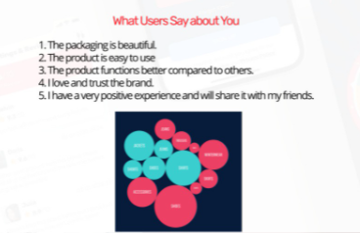
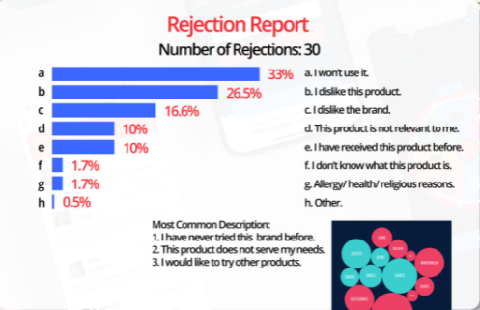
1. Open-ended questions

Slide 3
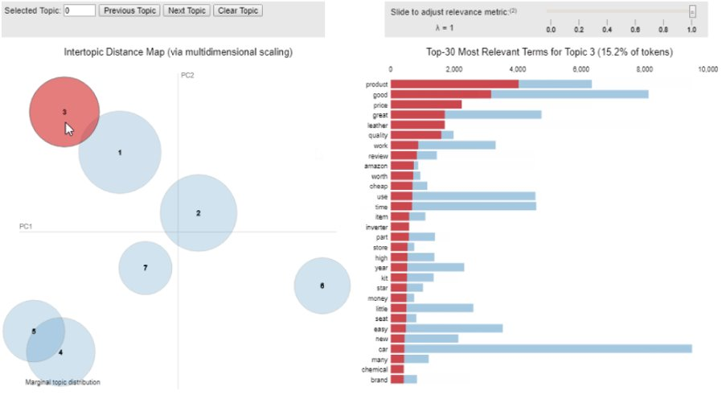
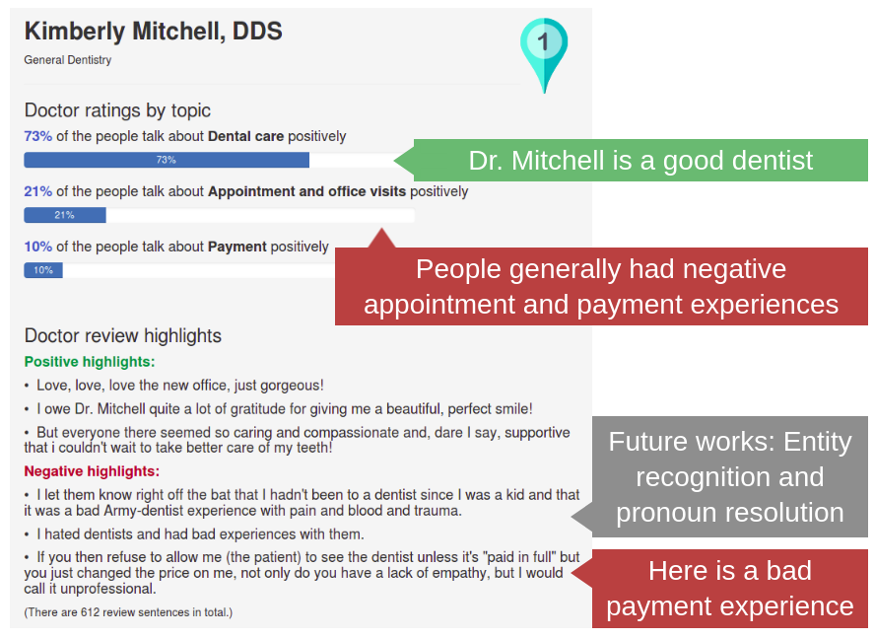
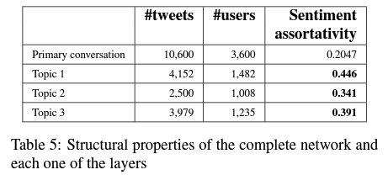
1. Automatically identify general topics mentioned in all comments about the product
Example topics:
Packaging
Size and weight
Taste
Hard to use
Distrust of product
Or 3. Show % of users who felt positively /negatively about each topic
2. For each topic, show the # of users, reviews and the overall sentiment (how positive/negative people felt about those topics)

Slide 4
Rejection Report
Topic​ | # reviews​ | % of total​ | Overall Sentiment Score (0-1)​ | % positive reviews​ | % negative reviews​
Overall​ | 30​ | 1​00% | 0.39​ | 40% | 60%
Uncertainty about brand​ | 13​ | 43​% | 0.23​ | 4​4% | 56%
Own similar product​ | 7​ | 23​% | 0.49​ | 43% | 57%
Not interested​ | 10​ | 33​% | 0.54​ | 50% | 5​0%
* 1 is positive, 0 is negative
* For rejection report, if too little rejections (<100), would suggest not to conduct as too little for analysis

Slide 5
What Users Say About You
Topic​​ | # reviews​​ | % of total​​ | Overall Sentiment Score (0-1)​​ | % positive reviews​​ | % negative reviews​​
Overall​​ | 2050 | 100% | 0.566063415 | 67% | 33%
Packaging​ | 294 | 14% | 0.59 | 61% | 39%
Product usability​ | 465 | 23% | 0.62 | 63% | 37%
Comparison with competitors​ | 362 | 18% | 0.41 | 35% | 65%
Dimensions and weight​ | 497 | 24% | 0.49 | 43% | 57%
Comments on the brand​ | 432 | 21% | 0.71 | 78% | 22%
* 1 is positive, 0 is negative
* For rejection report, if too little rejections (<100), would suggest not to conduct as too little for analysis

Slide 6
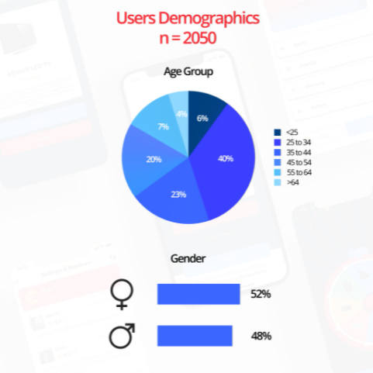
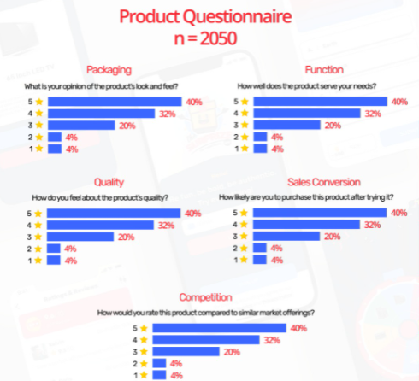
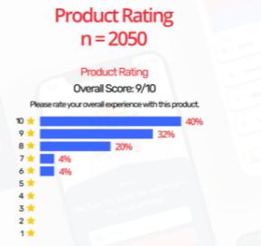
2. Demographics + Ratings

Slide 7
2. Demographics + Ratings
For this, we can automatically test different combinations of the most relevant demographic combinations (age group, gender, etc.) to show the client which segment of the population like the product the most/the least.
Ie.
Your product is liked best by "Females between 26-30!"
Your product is found to be High Quality by "Males between 19-25!"

Slide 8
Suggestion
Can consider allowing clients to choose which segments of society (I.e. age group and gender, etc) that they want to focus the analysis on. Then we can run the entire code and analysis on (1) the entire dataset, and (2) only the segment(s) of the market that they are interested in, if any. Will be relevant to gender and age-oriented products
  For eg. Razer might "ignore" feedback from customers >40 years old
Can be a valued-added feature (for the future) where clients can choose to have our analysis done on multiple segments of the market, separately or together, for their own information. Customer has to decide which segments to test our analysis on.

